Slide 1
Cloud and Virtualization Panel
Philip Papadopoulos
UC San Diego

Slide 2
PRAGMA Virtualization Panel
1. What types of virtualization technologies are likely to be of most interest to pragma members
2. What is the most important aspect of Virtualization/Cloud to you?
3. What is fundamentally different about Cloud computing vs. Grid Computing
4. What elements of the Grid SW stack should go forward as the community moves towards cloud computing?
Which should be dropped.
5. What are your predictions about virtualization and cloud computing.

Slide 3
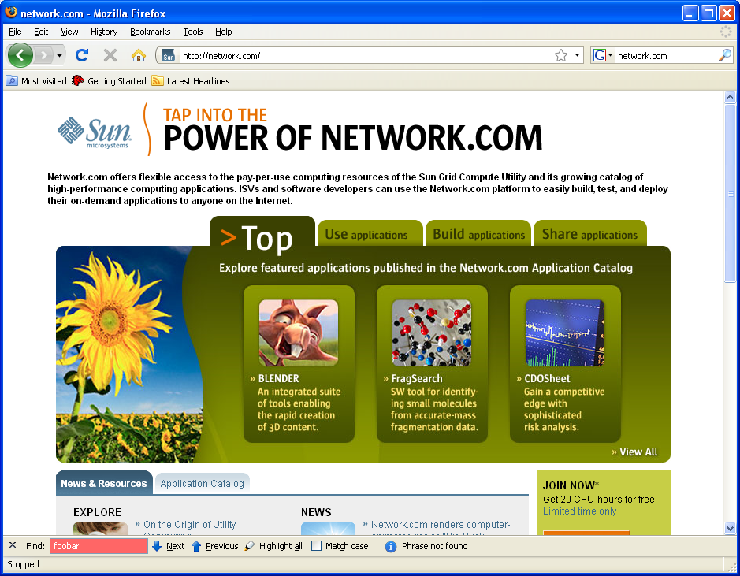
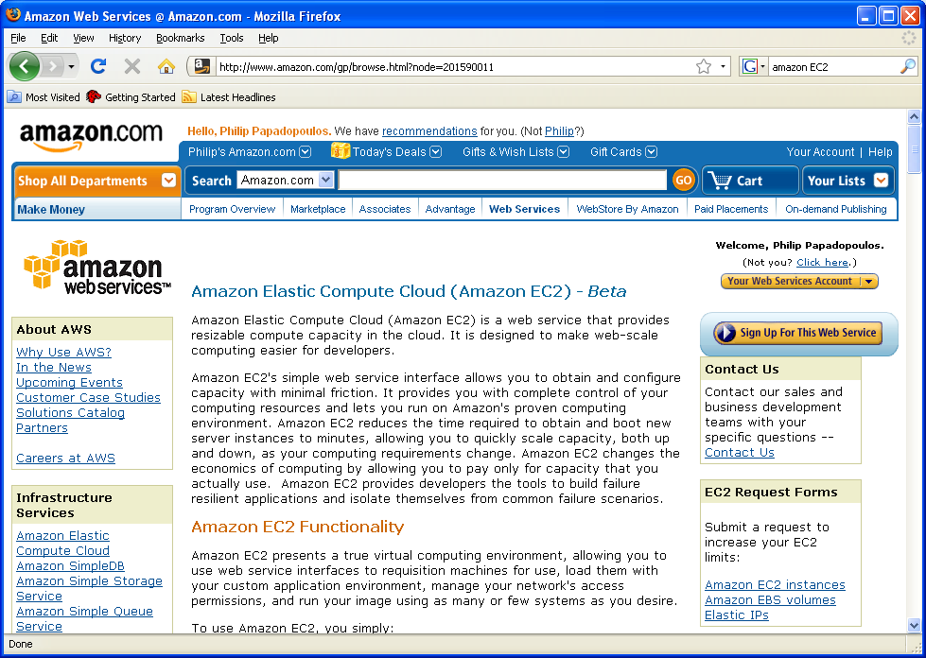
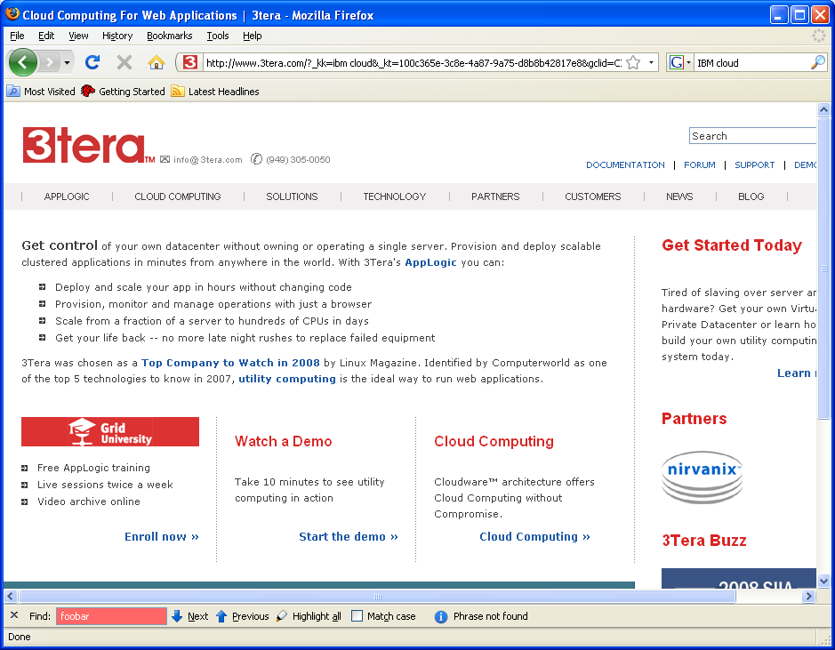
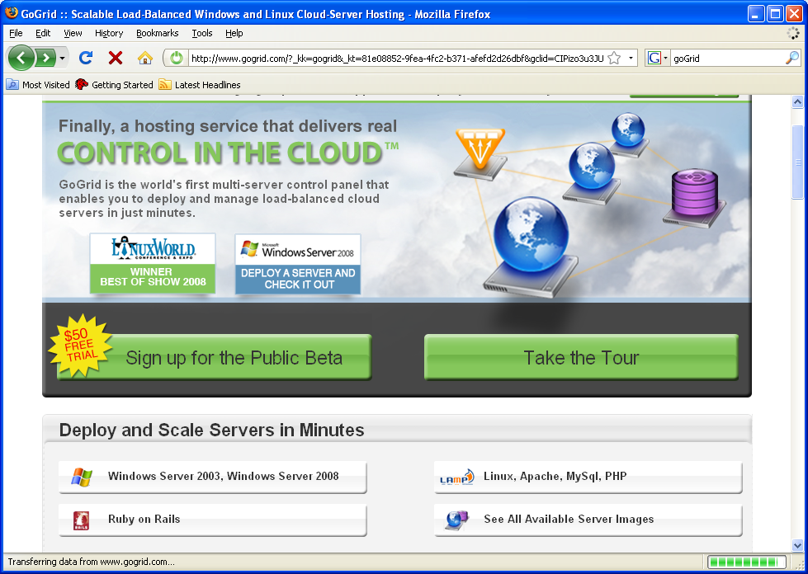
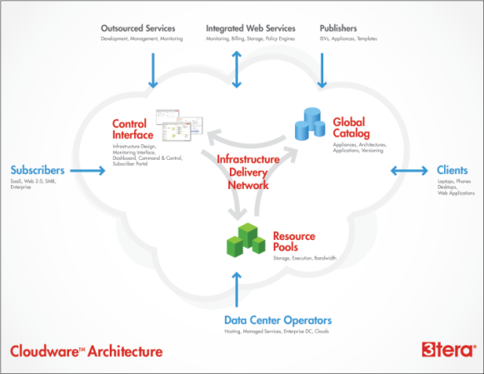
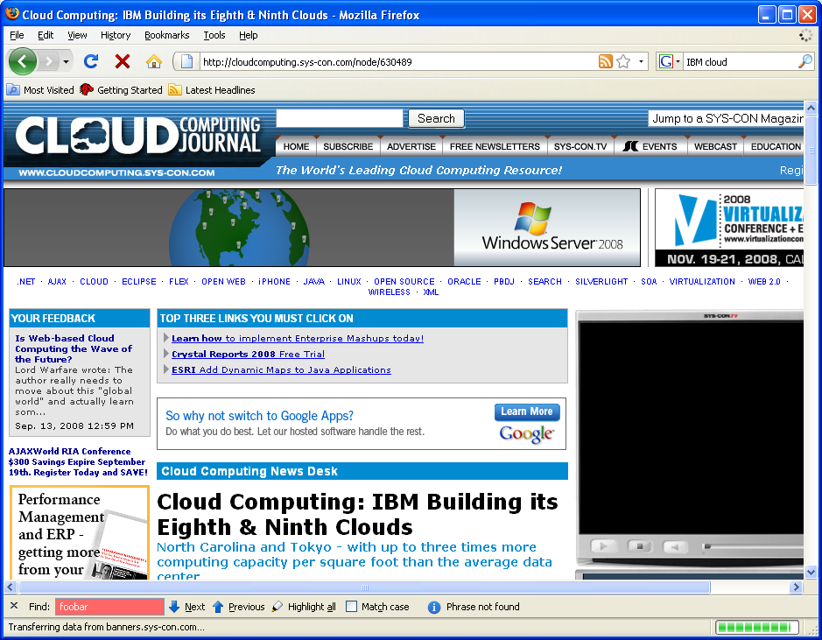
IaaS – Of Most Interest to PRAGMA
Sun
Amazon EC2
3Tera
GoGrid
IBM
Run (virtual) computers to solve your problem, using your software

Slide 4
SAAS vs IAAS?
SAAS = Software as a Service
  Perhaps.
    Geogrid is using web services
    Avian Flu Grid can use Opal services
But, We still have to implement services
IAAS = Infrastructure as s Service
  Portable Software infrastructure
  Can build PRAGMA – Application Environments—
    Not a single IT environment

Slide 5
2. What is the most important aspect of Virtualization/Cloud to you?
Ability to extend your cluster/environment to use “machines in the cloud” for
  Expanded computational capability
  Moving your application stack much closer to large data

Slide 6
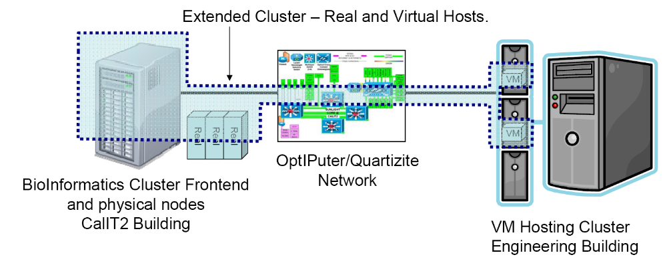
Campus Cloud: Cluster Extension
VMs: Software/OS defined by the frontend:
  Users, file system mount, queuing system, software versions, etc

Slide 7
3. What is fundamentally different about Cloud computing vs. Grid Computing
Cloud computing – You adapt the infrastructure to your application
  Should be less time consuming
Grid computing – you adapt your application to the infrastructure
  Generally is more time consuming
Cloud computing has a financial model that seems to work – grid never had a financial model
  The Grid “Barter” economy only valid for provider-to-provider trade. Pure consumers had no bargaining power

Slide 8
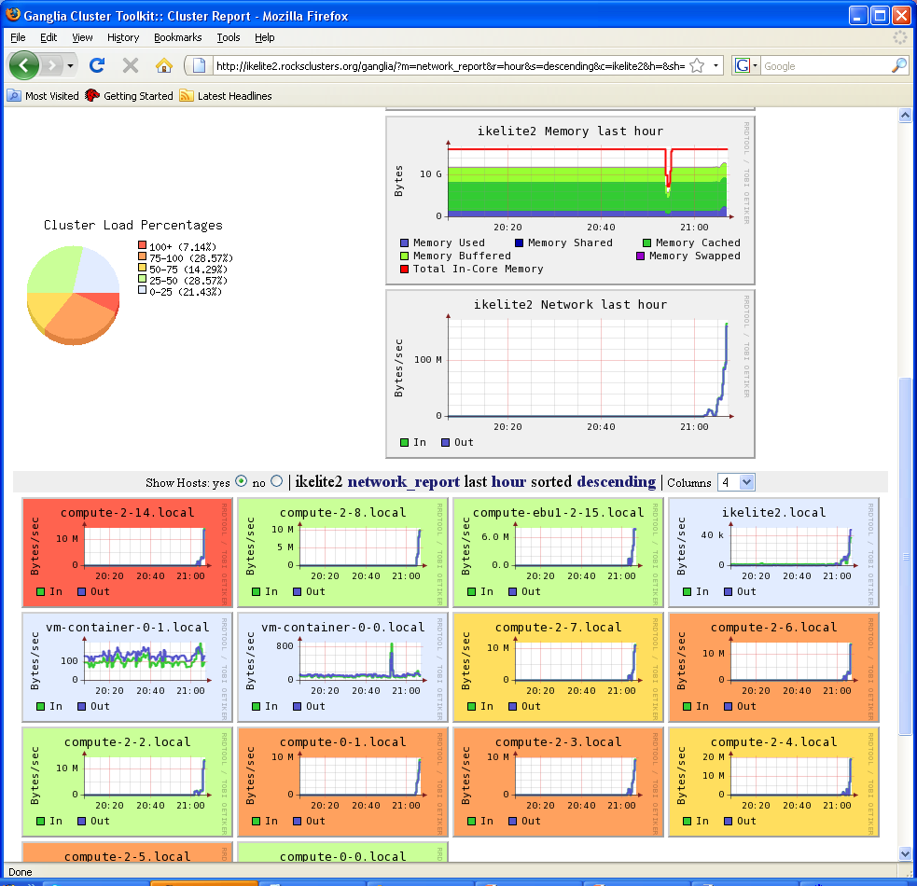


Cluster Extension – CAMERA Meta Genomics
Ikelite2.Rocksclusters.org
Config is CAMERA-defined
  BLAST, MrBayes,, MPI-BLAST, GROMACS, … (Bio Tools)
  CAMERA Users, File System Mounts, Queuing System, etc.
  All “Compute” Nodes are Virtual machines
Rocks 5.1 software structure makes this very straightforward

Slide 9
4. What elements of the Grid SW stack should go forward as the community moves towards cloud computing?
Which should be dropped.
The following is planned for Globus version 5
  GRAM (version 2)
  GridFTP
  GSI-ssh
  MyProxy
  RLS (Replica Location Service)
Keep
  Identity Management/PKI
  IGTF
  GridFTP seems Useful to some people.
Drop almost everything else
  Need much lighter grid infrastructure to
    Start VMs
    Move data

Slide 10
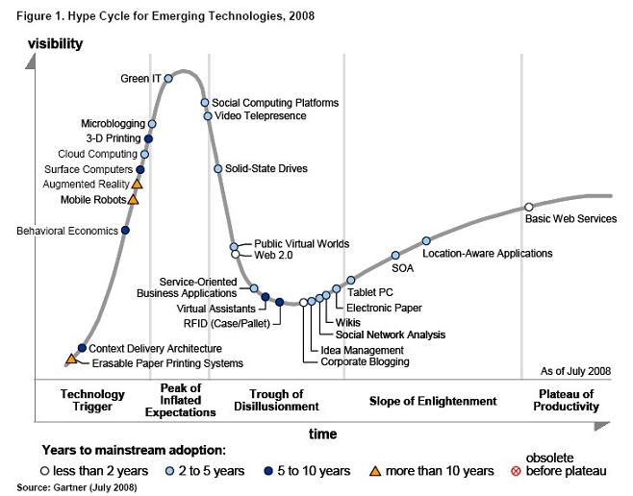
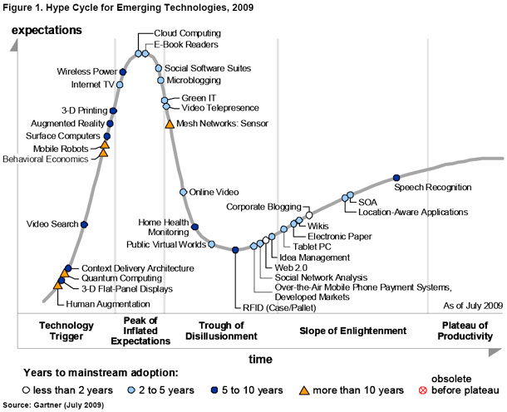
Cloud Hype Cycle - Gartner
2008
2009
GRID

Slide 11
5. What are your predictions about virtualization and cloud computing.
Hardware – (Intel,AMD) build chips with Hypervisor in HW (~5 years)
Cloud is almost at the peak (or has crossed) over the Gartner Hype Curve
  Success of Cloud Computing Driven by economics
Large-Scale data is the driving factor
  Even with “big” networks, data sets of > 1TB are long ways away
    Move your computing to where data is located
    → Where to put your data is the key decision point

